Slide 1
4. Depth-limited search
Depth-limited search is similar to depth-first search with a predetermined limit.
Depth-limited search can solve the drawback of the infinite path in the Depth-first search.
In this algorithm, the node at the depth limit will treat as it has no successor nodes further.
Depth-limited search can be terminated with two Conditions of failure:
Standard failure value: It indicates that problem does not have any solution.
Cutoff failure value: It defines no solution for the problem within a given depth limit.

Slide 2
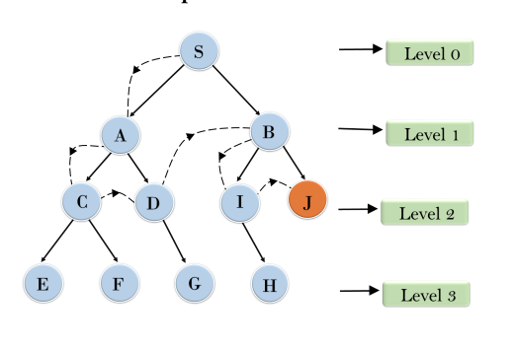

Slide 3
Advantages:
Depth-limited search is Memory efficient.
Disadvantages:
Depth-limited search also has a disadvantage of incompleteness.
It may not be optimal if the problem has more than one solution.

Slide 4
Evaluation
Completeness: DLS search algorithm is complete if the solution is above the depth-limit.
Time Complexity: Time complexity of DLS algorithm is O(b^{ℓ}).
Space Complexity: Space complexity of DLS algorithm is O(b×ℓ).
Optimal: Depth-limited search can be viewed as a special case of DFS, and it is also not optimal even if ℓ>d.

Slide 5
5. Iterative deepening search
The iterative deepening algorithm is a combination of DFS and BFS algorithms.
This search algorithm finds out the best depth limit and does it by gradually increasing the limit until a goal is found.
This algorithm performs depth-first search up to a certain "depth limit", and it keeps increasing the depth limit after each iteration until the goal node is found.
This Search algorithm combines the benefits of Breadth-first search's fast search and depth-first search's memory efficiency.
The iterative search algorithm is useful uninformed search when search space is large, and depth of goal node is unknown.

Slide 6
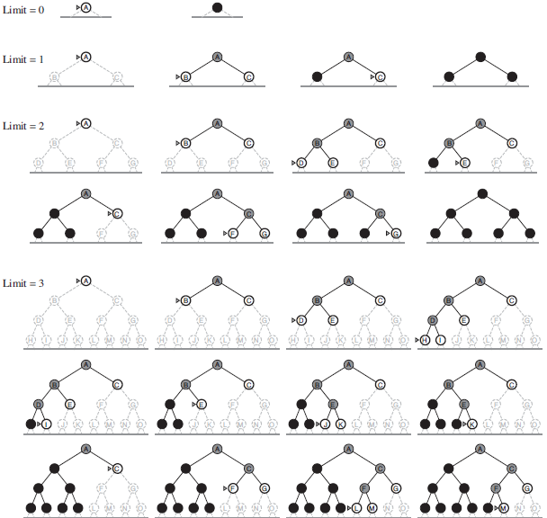
Four iterations of iterative deepening search on a binary tree.

Slide 7
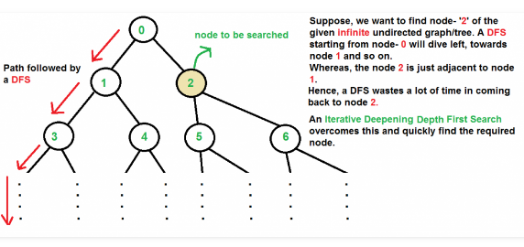
Graph with infinite nodes

Slide 8
There can be two cases- a) When the graph has no cycle: This case is simple. We can DFS multiple times with different height limits.
b) When the graph has cycles. This is interesting as there is no visited flag in IDDFS (convert graph into tree).

Slide 9
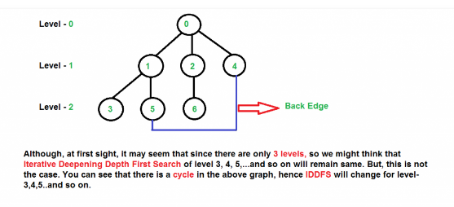
Graph with cycles

Slide 10
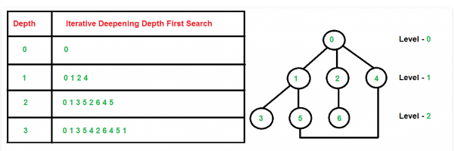

Slide 11
Advantages:
It combines the benefits of BFS (when result is at shallower node) and DFS search algorithm (stack data structure is used) in terms of fast search and memory efficiency respectively.
Disadvantages:
The main drawback of IDDFS is that it repeats all the work of the previous phase.

Slide 12
Evaluation
Completeness:
This algorithm is complete is if the branching factor is finite.
Time Complexity:
Let's suppose b is the branching factor and depth is d then the worst-case time complexity is O(b^{d}).
Space Complexity:
The space complexity of IDDFS will be O(bd).
Optimal:
IDDFS algorithm is optimal if path cost is a non- decreasing function of the depth of the node.

Slide 13
Bidirectional search
The idea behind bidirectional search is to simultaneously search both forward from the initial state and backward from the goal, and stop when the two searches meet in the middle.
Predecessor nodes should be known for searching
backwards from the goal node.
Time complexity O(b^d/2) and space complexity O(b^d/2)

Slide 14
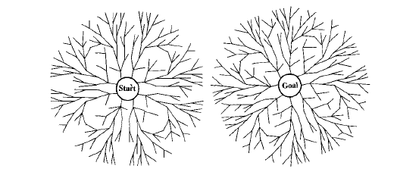
A schematic view of a bidirectional breadth-first search that is about to succeed, when a branch from the start node meets a branch from the goal node.

Slide 15
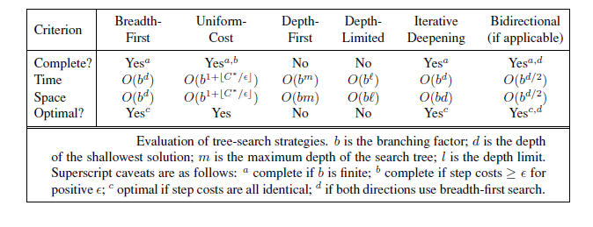
Comparing search strategies

Slide 16
AVOIDING REPEATED STATES
Do not return to the state you just came from.
Do not create paths with cycles in them.
Do not generate any state that was ever generated before. This requires every state that is generated to be kept in memory, resulting in a decreased space complexity.

